Slide 1

Mind, Body, Spirit: A
Community Program to Create Connection

Slide 2
Why MBS?
MBS is a 6 week program designed to reduce isolation and increase connection among older adults
It started in 2021 through Waltham Connections for Healthy Aging (Connections) and replicated in Wareham the next year
Connections is a coalition of older adult activists, public and private agencies, including JF&CS, Waltham COA, Healthy Waltham, Brandeis, etc.
During the pandemic, Connections continued to meet virtually and plan for ways for older adults to come together
Notes:
kk

Slide 3
MBS in Waltham
We were hearing about how lonely people were feeling with descriptions of solitary, daily trips to the grocery store as a way to see others
Although there were offerings through the COA on zoom and cable TV, they were mostly exercise, and few ways to connect people and really engage with others
We looked to the literature on social isolation and best practices in promoting connectedness for older adults
We also wanted to make this a team effort
Notes:
kk

Slide 4
Literature on Social Isolation
Social interaction is very important
Individuals who are more socially connected have a 50% reduced risk of early death relative to those who are less socially connected
Between 33% and 43% of all older adults in the U.S. experience loneliness, either sometimes or frequently National Academies of Sciences, Engineering, and Medicine. 2020.
One in five older adults say their mental health has gotten worse since the pandemic began. National Poll on Health Aging, March, 2021.
This is so important that in some countries, like England, there is a Minister of Loneliness
Notes:
ka

Slide 5
Strategies For Coping
As we thought about the design, we found a 2021 report from the Suicide Prevention Resource Center, on strategies for promoting successful coping including:
Seek out regular moments of pleasure, meaning, and mastery
Maintain social connectedness and sense of belonging. Some ways in which older adults can maintain connection and a sense of belonging are through virtual social activities, exercise classes, or meetups.
Incorporate ways to experience relaxation and calm. Mindfulness, deep breathing, imagery, yoga, or stretching, can increase older adults’ sense of control, confidence, and focus.
Engage the mind. Keeping the mind active is associated with a number of positive cognitive, emotional, and physical health outcomes.
Engage the body. Regular physical activity is one of the most important things older adults can do for maintaining heart and brain health, reducing stress, and improving mood. Even just 20 minutes of exercise or movement can make a difference.
Notes:
ka

Slide 6
Mind, Body, Spirit Overview
We kept these in mind as we designed a curriculum
In April and May of 2021, Connections held a 6-week zoom program entitled Mind, Body, Spirit (MBS) for older adults living in Waltham
The program was designed to be interactive and give participants a chance to connect not only with the material -- but also with one another
Funding was provided by McLean Hospital through CHNA 18
Notes:
ka

Slide 7
The Team: Collaboration for Mind, Body, Spirit
Waltham Council on Aging publicized the program through newsletters and assisted with registration logistics.
Healthy Waltham also helped with outreach and program publicity through newsletter and social media.
Connections volunteers provided program design and evaluation leadership.
Hired a program coordinator who implemented outreach, recruitment, engagement, and facilitated the weekly groups.
Presenters were content experts with experience working with older adults. Many were already part of the Waltham network, making it easier to onboard them to the project. MBS offered a modest honorarium for presenters.
Notes:
ka

Slide 8
Waltham Curricula
Week 1- Mind
Waltham’s History—Places that Matter
Week 2 -Mind
Journaling—The Rewards of Recording Thoughts, Reminiscences and Experiences
Week 3 -Body
Move it & Use it
Week 4 -Body
Yoga—Gentle Stretch
Week 5- Spirit
Emotional Well-Being
Week 6 -Spirit
Mindfulness—The Joy of Breathing
Notes:
Ka
We believed it should be a group activity “Groups can serve as an effective antidote to social isolation and loneliness. Groups provide a place to be cared about and to care about other people. They provide a valuable sense of belonging and being a part of community.” Hubie Jones, former Dean at Boston University School of Social Work

Slide 9
MBS Program Format
Format designed to promote learner interaction
The six, weekly, 90-minute sessions
Each session included a 30-minute presentation on the selected topic, which we called Learn It
After each session, we gathered feedback from the participants on their thoughts about the session, which we called Like It?
At the end of the session resources related to the topic were offered, with the suggestion of Try It at home
Participants were encouraged to do Try It activities with a fellow participant, friend, or family member
Notes:
ka

Slide 10
MBS Outcomes Waltham
Initially 14 people signed up for the program. They had heard about the program from the COA newsletter and flyers in their buildings.
Eleven seniors attended the first session and continued to attend most sessions. Over the six weeks of classes, attendance was 84%.
Regular outreach (phone calls and emails) – and enthusiasm that translated through Zoom – were very important for maintaining engagement.
Four of the participants shared that English was not their first language, with two participants identifying as Spanish speaking and two participants identifying their first language as Chinese.
Notes:
ka

Slide 11
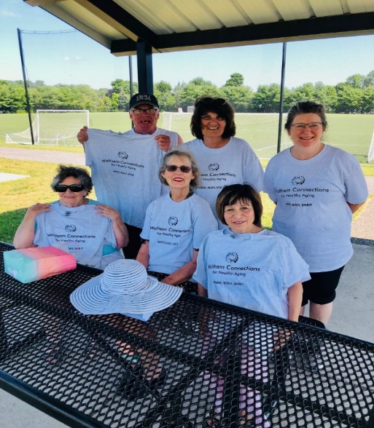
Mind Body Spirit: Connecting During COVID

Slide 12
Mind, Body, Spirit Wareham
In the fall of 2021, CADER reached out to colleagues and discussed replicating the Mind, Body, Spirit (MBS) for seniors living in Wareham
CADER wanted to include faith leaders
Chose Wareham because of relationship with Philomena Hare of the First Congregational Church of Wareham, United Church of Christ
Partners included
Boston University’s Center for Aging & Disability Education & Research
Old Colony Elder Services
Wareham Council on Aging
The First Congregational Church of Wareham, United Church of Christ
Funding was provided by MA DPH, Suicide Prevention Program
Notes:
nb

Slide 13
Mind, Body, Spirit Curriculum Wareham
Mind
Week 1- Journaling/Reminiscing
Week 2 -Memory & Creativity
Body
Week 3- Move It & Use It
Week 4- Gentle Yoga
Spirit
Week 5 – Emotional Wellbeing
Week 6- Mindfulness
Notes:
nb

Slide 14

Notes:
NB

Slide 15
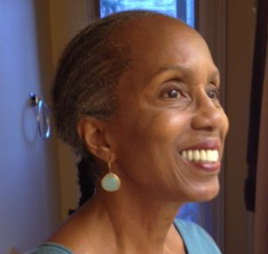
Week Two, Learn It: From Waltham but used in Wareham Journaling—The Rewards of Recording Your Thoughts, Reminiscences and Experiences
Presenter: Lynette Benton https://www.lynettebentonwriting.com
Philosophy: Journaling can be daily, occasionally, or randomly. Should be pressure free! (Ignore the “internal editor.” This is for your eyes only.)
Journaling Benefits: Solving problems, clarifying thoughts, ideas, and feelings
Renewing and reviewing memories
Reducing stress
Strengthening immune system
Uplifting spirits
Notes:
Trem

Slide 16
MBS in Action Today
Today we’ll recreate an MBS activity based on Lynette’s session
Please participate!
Select one and write for 5 minutes about…
A humorous story or occurrence
A surprise, whether good or bad
What does home mean to you?
How did you like it?
Can you see it building connections and community?
Notes:
TRe

Slide 17

MBS in Action
Learn It-
Facilitator talks about activity
Like it?
Go around the room
Thumbs up or thumbs down
Try it
Would you try journaling at home?
Notes:
tre

Slide 18
MBS Participant Evaluation
What did you most enjoy about participating in the Mind, Body, Spirit Program?
Did the Mind, Body, Spirit group experience meet your expectations?
Would you recommend MBS to your friends and people in the community? (circle one):
What are your thoughts about the format of the sessions: Learn it, Like it, and Try it?
Please select your top three MBS sessions (circle three):
Why did you select the three above?
We ask the following 3 questions to measure feelings of loneliness or isolation.
How often do you feel that you lack companionship? (circle one):
How often do you feel left out? (circle one):
How often do you feel isolated from others? (circle one):
1-Hardly ever
2-Some of the time
3-Often
Would you participate in MBS again? (circle one)
Share your thoughts on some ways to get others to participate in MBS.
If you could change something about MBS, what would it be:
Please provide any additional feedback for us to improve MBS in the future.
Notes:
ka

Slide 19
Participant Feedback- Waltham
“Thank you for the many hours of hard work you and your team put into giving this course called “ Mind, body spirit”. I think the topics were diverse and offered something to each participant. I appreciated the recordings, the web site addresses and the information covered by each presenter. It is so good to just listen and know the information will be sent later by email.”
“We had a diverse group of participants and I would like to hear their experiences of facing discrimination or everyday issues. …Again the cultural diversity of the class was a valuable asset for understanding others in the group.”
“I have made contact and we’ll go for a walk, when we have a chance. Good job”
“This program covered a lot about Mind, Body, Spirit. I think I get lot. I take notes, and I can practice later for the yoga, and the meditation. And also for the history part; I also like that – that was interesting.– about 3 tools for meditation – that is simple and clear, and we can practice every day.”
Notes:
ka

Slide 20
MBS Participant Evaluation Waltham
What did you most enjoy about participating in the Mind, Body, Spirit Program?
Facilitator was excellent, energetic and informative.
Enjoyed the interactions, the people (speakers)
Trying something new -people have to open their mind for 6 weeks
What are your thoughts about the format of the sessions: Learn it, Like it, and Try it?
It was good, try it was able to participate at home
Built on itself - discuss stuff with self, lives alone, thinks about it after class (Try it)
I liked it, especially with journaling, I’ve heard of it, but I’ve never taken the time, and think that’s the problem, you have to set a time for that, but I enjoyed the opportunity
of trying it, if I could fit it in
If you could change something about MBS, what would it be:
Additional Sessions
Continue to offer to COA
More opportunities to socialize
Notes:
ka

Slide 21
Journaling Feedback from Wareham Participants
What one thing did you learn today about journaling that you did not know before?
Expressing your thoughts allows you to see things from a different perspective
A tool you can use when you're upset
What the word means
There's no right or wrong way to do it
Will try journaling on own
Notes:
nb

Slide 22
Implementation Plan for MBS
Establish your stakeholders
CADER, OCES, Wareham COA, and First Church
Recruit and hire facilitator
OCES identified a staff person who was interested in the role of facilitator- Tremeda Martin
Interviewed by the team and took the role
Position was funded through DPH grant
Plan sessions
Wareham COA offered the COA for the program, publicized it through newsletters, and assisted with registration logistics
Team and facilitator identified presenters
Contact and enlist presenters
Facilitator r secured and oriented presenters
Outreach to and enroll participants
Outreach by OCES, First Church and Wareham COA
COA publicized it through newsletters, assisted with registration logistics
Complete program
Regular team check-ins
Run an evaluation
Notes:
nb

Slide 23
MBS Budget
Honoraria for speakers: 6 speakers
Facilitator:- 5 hours a week, x 16weeks – 80 hours
T shirts or blank journal
Printing
Notes:
tre

Slide 24
Discussion Opportunities & Challenges in a Time of Increasing Social Isolation
What are the greatest challenges for decreasing social isolation?
Can you see doing an MBS program in your community?
Do you see it as different from regular COA/ASAP programming?
Can MBS decrease social isolation in ASAP/COA clients?
Can it serve as an introduction to the COA/ASAP for new participants?
Can it serve as an introduction to new kinds of activities?
Would having a facilitator manual make a difference?
Could you see MBS being a tool to reach older adults in different settings and with different populations eg -Congregations, linguistic groups, LGBTQ?
If so, how could we change it to reach those populations?
Notes:
all

Slide 25
Today’s Presenters
Kathy Kuhn
BU CADER, Special Projects
kkuhn@bu.edu
Nandy Barbosa
MSW Intern (21-22), BU CADER & Case Manager, Boston Senior Home Care
nbarbosa@bshinfo.org
Karla Armenoff
MSW Intern (21-22)
karmenoff@bu.edu
Tremeda Martin
Old Colony Elder Services
tmartin@ocesma.org
Notes:
KK

