Slide 1


Taking a Stand Against Ageism throughout Medical Training

Slide 2
Relevant Disclosures
Dr. Ramawamy is the Assessment Lead for Aquifer Geriatrics.

Slide 3
Objectives
At the end of this workshop, participants will:
Identify how ageism education embedded in medical education can change learner attitudes and combat bias against older adults and improve clinical care.
Describe strategies for incorporating curricula about ageism into pre-clinical and clinical years of medical school, as well as residency training, and fellowship.
Evaluate the impact of these strategies used to incorporate ageism education into the stages of medical training as well as how these strategies might mitigate the attitudes and behaviors developed throughout training that are biased toward older adults.
Discuss ways participants will amplify awareness of bias toward older adults and incorporate ageism education into their programs

Slide 4
What is Ageism?
“Discrimination against older people due to negative and inaccurate stereotypes.”
According to the WHO, the most pervasive and socially accepted form of discrimination
Become invisible, small, weak, ugly, useless, burdensome, impotent, cognitively impaired
  “If you took your entire view of the human race from primetime advertising alone, you’d see a society without old people. They don’t work, they don’t drink beer, they don’t drive cars. They don’t exist.” –Jeff Beer, Fast Company

Slide 5

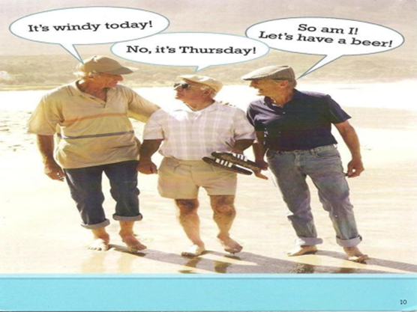

Slide 6
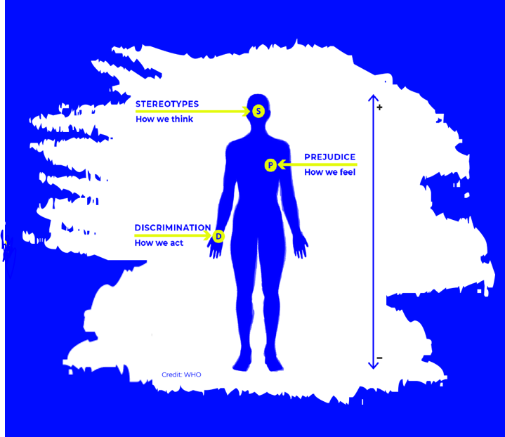
What is Ageism?
Ageism is a combination of three connected elements
Prejudicial attitudes towards older people, old age, and the aging process
Discriminatory practices against older people
Institutional practices and policies that perpetuate Stereotypes about elderly people.
WHO Global Report on Ageism, 2021
Notes:
Ageism refers to the stereotypes (how we think), prejudice (how we feel) and discrimination (how we act) directed towards people on the basis of their age.

Slide 7
Ageism is prevalent and harmful
Cross sectional survey of 2035 US adults 50-80 y, community
Everyday Ageism Scale vs health outcomes
Over 80% experienced at least some form
                Allen JO, Solway E, Kirch M et al. JAMA Network Open, June 2020

Slide 8
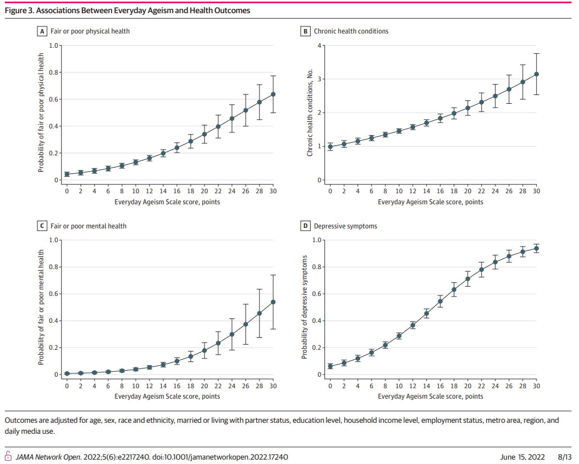

Slide 9
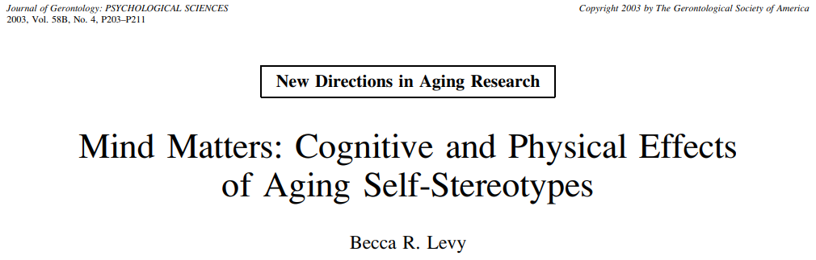
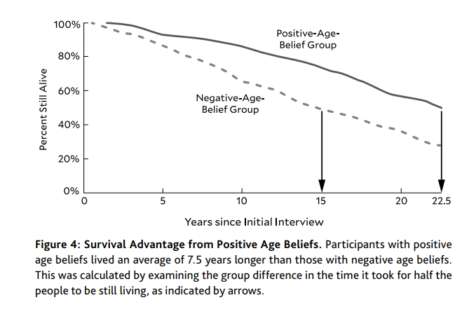
More positive views of aging with fewer ageist beliefs increases survival by 7.5 years and more likely to engage in preventive care

Slide 10
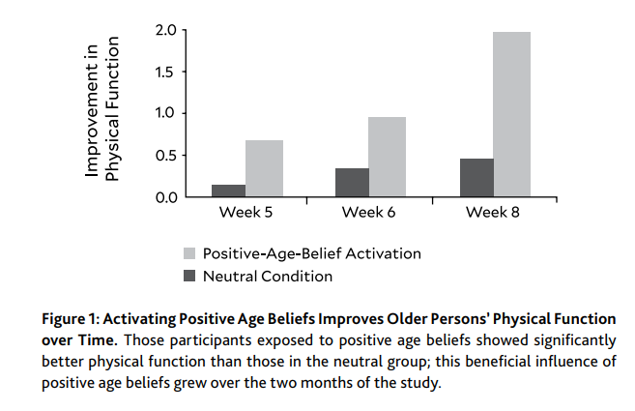
The good news: beliefs can change and health benefits ensue
Becca Levy, “Breaking the Age Code” 2022

Slide 11

How to Combat Ageism?
Policy and law
Educational activities
Intergenerational interventions
WHO Global Report on Ageism, 2021
Notes:
•Policy and law can address discrimination and inequality based on age and protect the human rights of everyone, everywhere. Different mechanisms are used to implement and monitor policies and laws, including human rights agencies, courts, ombudspersons and bodies working to uphold treaties.
•Educational interventions include instruction that transmits information, knowledge and skills, as well as activities to enhance empathy through role-playing, simulation and virtual reality; are among the most effective strategies for reducing ageism against older people.
•Intergenerational interventions aim to foster interaction between different generations. Interventions that combine education and intergenerational contact have a slightly larger effect on attitudes than intergenerational interventions used alone.

Slide 12
Structure for this session
Very brief overview of 4 educational programs to combat ageism in medicine
Join breakout table for discussion for 14 min x2
Regroup and share a few favorite ideas, themes garnered from breakouts
Evaluation 5 min

Slide 13
Objectives
At the end of this workshop, participants will:
Identify how ageism education embedded in medical education can change learner attitudes and combat bias against older adults and improve clinical care.
Describe strategies for incorporating curricula about ageism into pre-clinical and clinical years of medical school, as well as residency training, and fellowship.
Evaluate the impact of these strategies used to incorporate ageism education into the stages of medical training as well as how these strategies might mitigate the attitudes and behaviors developed throughout training that are biased toward older adults.
Discuss ways participants will amplify awareness of bias toward older adults and incorporate ageism education into their programs

Slide 14
Medical School Geriatric Clerkship: Curriculum Around Mental Health & Ageism
Bronwyn Keefe, MSW, MPH, PhD
Research Assistant Professor
Boston University School of Social Work
Megan Young, MD
Assistant Professor of Medicine in the Section of Geriatrics
Chobanian and Avedisian School of Medicine

Slide 15
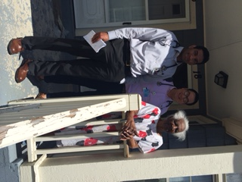
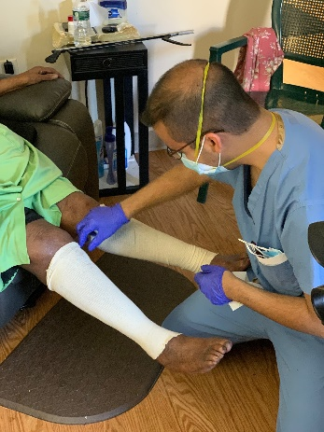
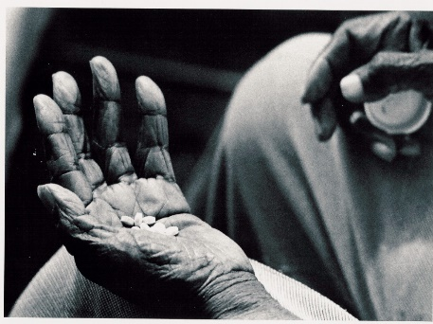
Description & Strategies
Required 4 week outpatient clerkship for medical students in the 4th year
Module focused on mental health and aging
Clinic
Home Visits
Nursing home

Slide 16
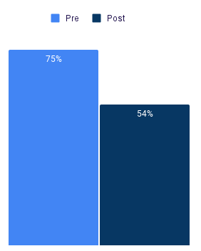
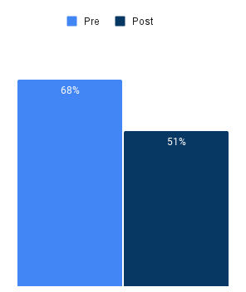
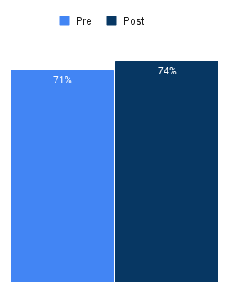
Results
Pre-post training results from the Attitudes Towards Aging Scale (Percent stated definitely true/somewhat true) N=69
The human body is like a car: when it gets old, it gets worn out
Having more aches and pains is an accepted part of aging
I expect that as I get older I will become more forgetful

Slide 17


Integrating Ageism Education with Clinical Experience in a Geriatrics Clerkship
Ravishankar Ramaswamy, MD, AGSF
Associate Professor
Stephanie Chow, MD, MPH Sharon Forbes, BBA Greg Hinrichsen, PhD
Noelle-Marie Javier, MD Amy Kelley, MD Rosanne Leipzig, MD, PhD

Slide 18
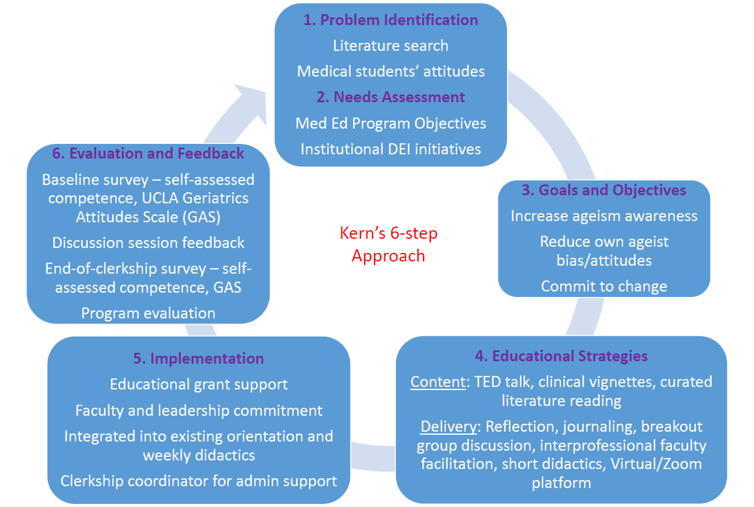
Curriculum: Description and Strategies
Priming
Visualization exercise
Case-based discussion
Commitment to change
Reflection & Journaling
Online repository
Notes:
At ISMMS, we have a 6-week Ambulatory care – geriatrics clerkship for 3rd year medical students. A prior analysis indicated a need for an empathy-based curriculum to improve medical student attitudes about older adults. Our objectives for an ageism awareness curriculum in the clerkship included:
To evaluate medical students’ attitudes towards older adults, and evaluate change after participation in an anti-ageism curriculum
To increase medical students’ awareness of the deleterious consequences of ageism in healthcare and of mitigating strategies, through self-directed learning, facilitated discussion and structured reflection
To assess feasibility of an anti-ageism, anti-racism and anti-bias curriculum in a core clinical clerkship

Slide 19
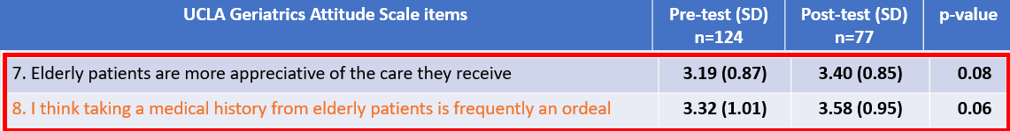
Results
Notes:
We surveyed to gauge students’ self-assessed awareness, confidence and interest in learning about ageism as well as their responses to the UCLA GAS at the start of the clerkship and at the end of the 6-week clerkship. In addition, we surveyed learner satisfaction after the didactic session and programmatic evaluation and feedback at the end of the clerkship.
130 students completed the curriculum in AY 2021-2022
124 (95.4%) completed the baseline survey
77 (59.2%) completed the end-of-clerkship survey
The median age for when a person is considered “old” was 70 years (range 35-90, mean 67.6 years).
21 out of 124 respondents (17%) endorsed having prior formal curriculum or teaching on ageism.
The ageism awareness education appeared to be associated with:
An increase in medical students' perception that elderly patients are more appreciative of the care they receive
A decrease in medical students' perception that taking a medical history from older patients is frequently an ordeal

Slide 20
Taking a Stand Against Ageism:
Anti-Ageism Interventions in Primary Care Residency Training
Mallory McClester Brown, MD
Clinical Assistant Professor
University of North Carolina School of Medicine
Department of Family Medicine
Division of Geriatrics

Slide 21
Anti-Ageism Interventions in Primary Care Residency
Didactic Sessions
“Call Me In”
Geriatric Month
Geriatric Workshops
Ageism Case Based Lecture
Geriatric Rotation
Specific Readings
1:1 Tracking our Biases
Impact on Care
Notes:
Strategies
“Call Me In” Session
Ageism: Case Based Teaching
Tracking our Biases:
1:1 Lessons with Preceptors
Geriatric Rotation Activities
AGS: Exploring the Intersection between Structural Racism and Ageism

Slide 22
Results
Qualitative Outcomes:
“As a young physician, I never stopped to think about ageism and how it factors into my patient’s care”
Resident Attitudes throughout Training
Notes:
Harvard Implicit Bias test

Slide 23
Taking a Stand Against Ageism:
Ryan
Brent

Slide 24
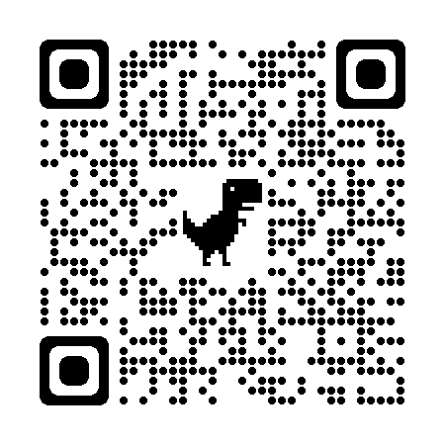
Ageism Curricula in Fellowship Training
Ageism Curriculum for Fellows
National experts
(Geri-a-FLOAT)
Flipped Classroom
Local discussions
(fellow-led)
Why build curricula for fellows?
Ageism is universal
Impacts us, our pts, & society
Fellows are future change agents!

Slide 25
National Impact & Outcomes
Float Session 1
N = 12 respondents
Float session 2
N = 2 respondents
Intent to change: 92%
Intent to change: 100%
Qualitative themes
Addressing ageism with pts (worries/fears/image/self-worth)
Personal language awareness
Recognition of others using ageist language
Willingness to intervene when ageism recognized
Language to use to intervene: “I noticed you said X. Tell me more about that”

Slide 26
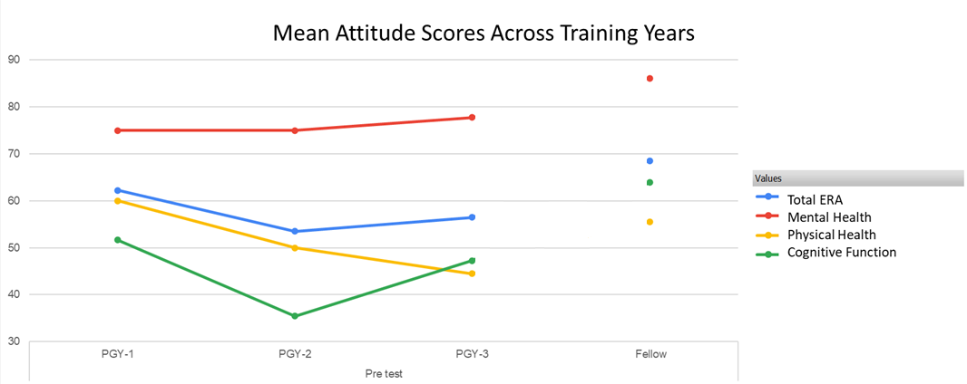
Local Impact & Outcomes
Resident Pilot (n=12)
Fellowship Pilot (n=3)
Evaluation: Mixed Methods
ERA
Prior Experience
Comfort levels identifying & addressing ageism
Practical takeaways & new strategies
Priority of education among SSDOH
Notes:
Of the 15 residents invited to participate, 12 residents (80%) completed both surveys. Responses were obtained from all training levels including 5 PGY-1 (42%), 4 PGY-2 (33%), and 3 PGY-3 (25%). Most residents (66%) had received at least some level of ageism education while in medical school. Sixty-four percent of residents ranked ageism as less important in their careers compared to other health equity-related topics such as sexism and racism. After participating in the workshop, residents had significantly higher total ERA scores and improved expectations regarding cognitive function (68 vs. 58, p = 0.012, 63 vs. 45, p = 0.003, respectively). Summed confidence scores for recognizing and confronting ageism increased after the workshop was given by 14% and 23% respectively.

Slide 27
Small Groups
14 minutes in two small groups

Slide 28
Take Home

